Slide 1
Scrum Team 2
Sprint 3

Slide 2
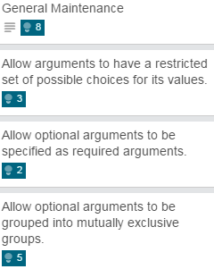
What was pulled?
Total Units Pulled: 18
Total Units Completed: 18

Slide 3
Testing & Code Coverage
100% Pass rate on unit testing
100% Pass rate on acceptance testing
98% Code coverage

Slide 4
Program Demos

Slide 5

Thank You For Your Time

